Slide 1
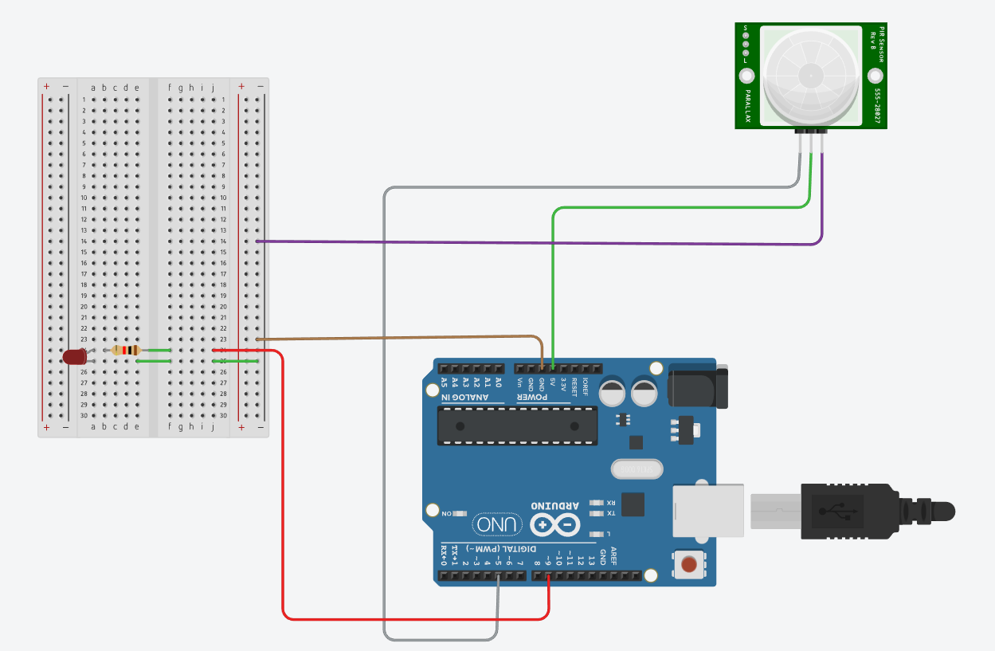
Motion Detection System

Slide 2
Motion Detection System
Detects movement of humans or animals in an area.
Uses a PIR sensor to sense motion.
Arduino processes the sensor signal.
Can trigger alarms, lights, or displays.
Used in security and automation systems.

Slide 3
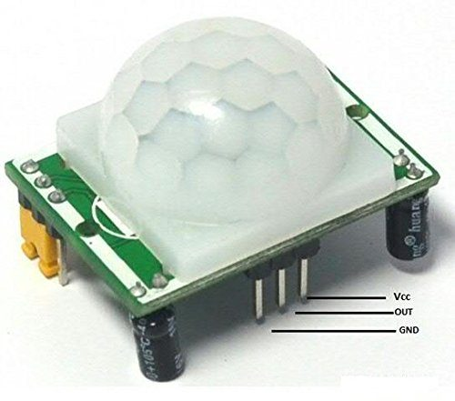
PIR Sensor
Detects motion by sensing infrared radiation.
Human bodies emit infrared energy.
When IR levels change, sensor outputs a signal.
Used in motion alarms and automatic lighting.

Slide 4
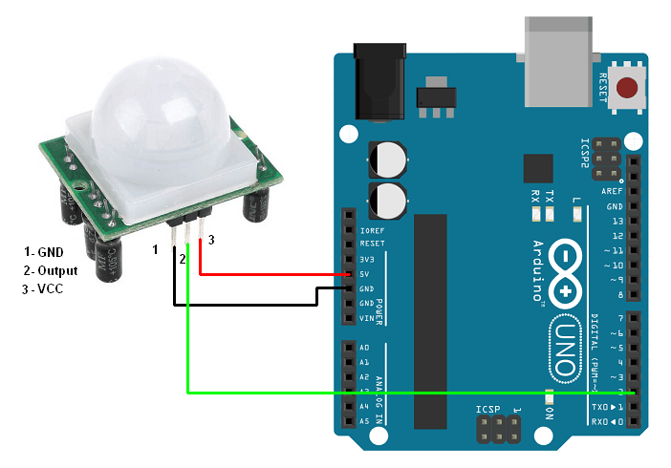
PIR Sensor Pins
GND – Ground connection for circuit completion.
VCC – Power supply input (5V).
Signal/OUT – Sends motion detection signal.
Signal becomes HIGH when motion is detected.

Slide 5
Circuit Connections
PIR GND → Arduino GND
PIR VCC → Arduino 5V
PIR Signal → Arduino Digital Input Pin
Optional: connect LED or buzzer for indication.

Slide 6
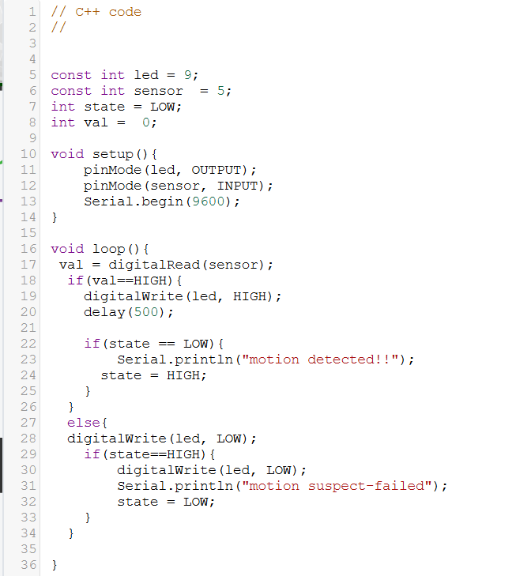
CODE.

Slide 7
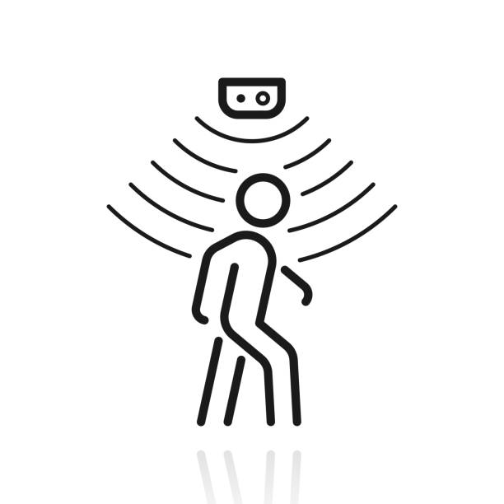
Working Principle
Sensor continuously monitors infrared radiation.
Movement causes change in IR pattern.
PIR outputs HIGH signal.
Arduino detects signal and triggers output.
Output shown via LED, buzzer, or display.

Slide 8

OVERALL SYSTEM

